Slide 1
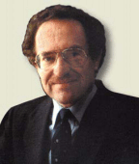
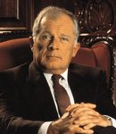
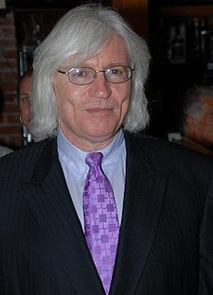
Criminal Defenses
Notable defense attorneys (L to R) Alan Dershowitz, Francis Lee Bailey, and Thomas Mesereau, Jr.

Slide 2
Andrea Yates – found guilty and sane, sentenced to life with possibility of parole after 40 years. Later on appeal, she was found not guilty by reason of insanity and is currently in a psych ward.

Slide 3
Mark Becker– found guilty and sane...sentenced to life without possibility of parole for killing his former coach/teacher

Slide 4
REMEMBER!!!
A trial is simply a contest between the prosecution and defense; a jury needs to decide who puts up a better case
The burden of proof rests on the prosecution; they must prove beyond a shadow of a doubt that defendant is guilty
Jury must unanimously agree with prosecution in order to convict defendant

Slide 5
Possible Defenses
“No Crime Has Been Committed” Defense
1) evidence is presented to show that a crime DID NOT take place
2) must prove that there was not criminal intent in the action (it was a mistake or accident)
If you accidentally walk off with someone else’s leather jacket , honestly thinking that it is yours, you should not be charged with larceny.

Slide 6
Possible Defenses (cont’d)
“Defendant Did NOT commit the Crime” Defense
1) defense admits that a crime HAS taken place
2) defense must prove that defendant was not the perpetrator
The OJ Defense…need we say more?

Slide 7
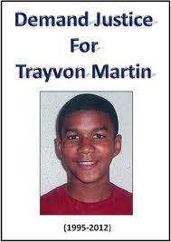
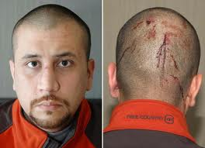
Possible Defenses (cont’d)
Ya feelin’ lucky punk?!
“Criminal Action Was Justifiable” Defense
1) act was done out of self-defense or defense of property
2) rule of thumb: defensive action cannot turn into excessive force
The controversial Castle Doctrine (better known as the “Make My Day” law) allows residents in West VA, Delaware, Washington, Wisconsin, North Carolina, and New Mexico to use deadly force to defend their property. Florida has the “Stand your ground” law. It is the center of the George Zimmerman trial (June 2013). Zimmerman shot/killed Martin (Spring 2012)

Slide 8
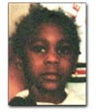
Possible Defenses (cont’d)
“Defendant Is Not Criminally Responsible Due To…” Defense
1) infancy – Supreme Court ruling in 1893, said children under 7 years old are not held responsible for criminal action
This is youngest school shooting in history of US
When: Feb. 29, 2000
Where: Flint, Michigan – Elementary School
Victim: 6 year old Kayla Rolland (left)
Shooter: 6 year old Dedrick Owens (right)
Details: 1 shot in arm while class was changing subjects…no motive. Bullet passed through vitals. Died later that day.
Charged: Owens was not charged with a crime due to inability to form intent
His uncle was charged with involuntary manslaughter (2.5 years). Owens found gun at his uncle’s house.

Slide 9
Not Criminally Responsible (cont’d)
2) entrapment – defendant was coerced to commit the crime by an undercover law enforcement official
Very difficult to prove entrapment by the police
If this were an undercover cop posing as a prostitute, and she approached the person in this car with an offer of sex for money which was accepted, could the person in the car claim entrapment?

Slide 10
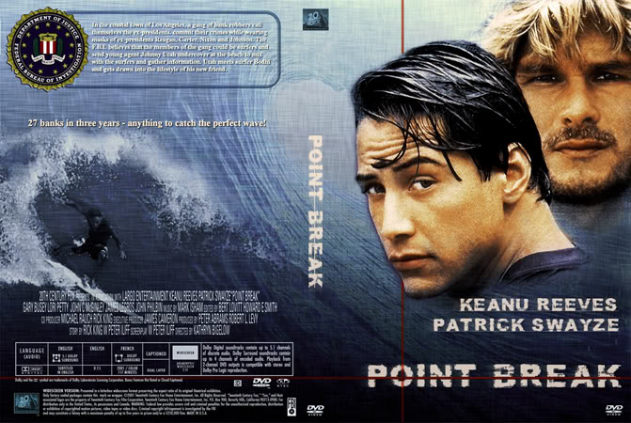
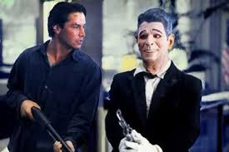
Not Criminally Responsible (cont’d)
3) Duress/Necessity – defendant committed the crime because of threat of immediate danger to his/her life or to preserve his/her life
If this person with a gun to his head was forced to commit a crime by the assailant holding the gun, he could claim duress or necessity as his defense

Slide 11
Possible Defenses (cont’d)
“By Reason of Insanity”
1) defendant lacks “substantial capacity” to understand how severe actions are (“does not know right from wrong or understand the consequences of their actions”
2) defendant suffers from a documented or later proven mental defect (schizophrenia, delusions, etc.)
3) only used as a defense in about 1% of all criminal cases; when it is used, it is only successful 25% of the time
McNaghten Rules standard used to measure the mental state of a defendant. (Named after Daniel McNaghten who in 1843 attempted to assassinate the British Prime Minister)
FYI….the Insanity Defense is accepted in : Australia, Canada, Wales and England, Hong Kong, New Zealand, Ireland, India, and the US (but not in MT, KS, ID, UT)
Would-be Presidential assassin John Hinckley Jr. was declared “not guilty by reason of insanity” in 1982. He remains in psychiatric care as of today.

Slide 12
Assassination Attempt on Pres. Reagan
http://www.youtube.com/watch?v=N1Jid5uRFo4

Slide 13
Your Assignment:
On pages 130-131, you will read over a case study concerning a young man named Sean Webster and his attorney’s decision to plead insanity
In groups of 3-4, you are to answer questions A through M (one person records answers). We will discuss answers and collect them at the end of class

Slide 14
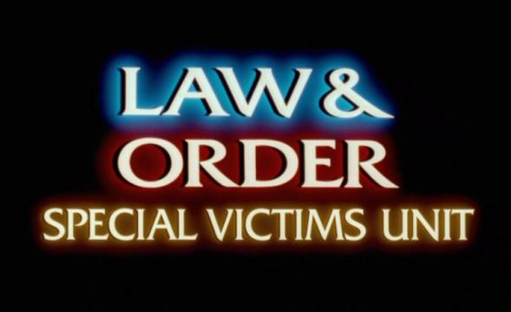

Slide 15
Bonus Episode!!!

Slide 16
Genetic Insanity??
In our brains, the prefrontal cortex is responsible for helping to control our actions, behavior, and emotions (particularly our urges to act out in a violent way)
If a person was born with some genetic abnormality to the prefrontal cortex, does this mean that a person is “mentally hardwired” to commit violent actions throughout their life?
If this could be medically proven, could it find a defendant not guilty by reason of insanity?

Slide 17
In This Episode…
Sean Webster has been arrested for the murder of two Muslims, a young woman and a young man. His defense attorney claims that due to a “genetic mental defect”, Sean is not responsible for his actions and should be found not guilty by reason of insanity.

